Slide 1



GREENSHIELD
FINAL CUSTOMER UPDATE
Group 1
Akhila Soodi Reddy (110117775)
Divyasree Geetha Balasubramanian (110117332)
Hoang Uyen Thu Le (110106222)
Vijaya Satwika Naidu Mandali (110116456)

Slide 2
Contents
01
Overview
02
Approach
03
What We Know
04
What Do We Diagnose
05
What Do We Predict
06
Recommendation

Slide 3

Overview of the Data
Data Composition:
Compilation of four distinct files: Departmental and Employee Performance Reports.
Encompassing operational metrics and workforce management.
Departmental Data Span:
Time Coverage: A three-year horizon from January 1, 2021, to December 31, 2023.
To evaluate long-term departmental trends and performance.
Employee Time Tracking:
Time Coverage: Focused three-month period from August 2023 to November 2023.
To assess recent employee work patterns and efficiency.

Slide 4

Approach
Identify and analyze the KPIs affecting department’s performance.
Identify and analyze the KPIs affecting employee’s performance.
To analyze the employee productivity with the help of predictive models.
To analyze overtime without leading to employee burnout.

Slide 5
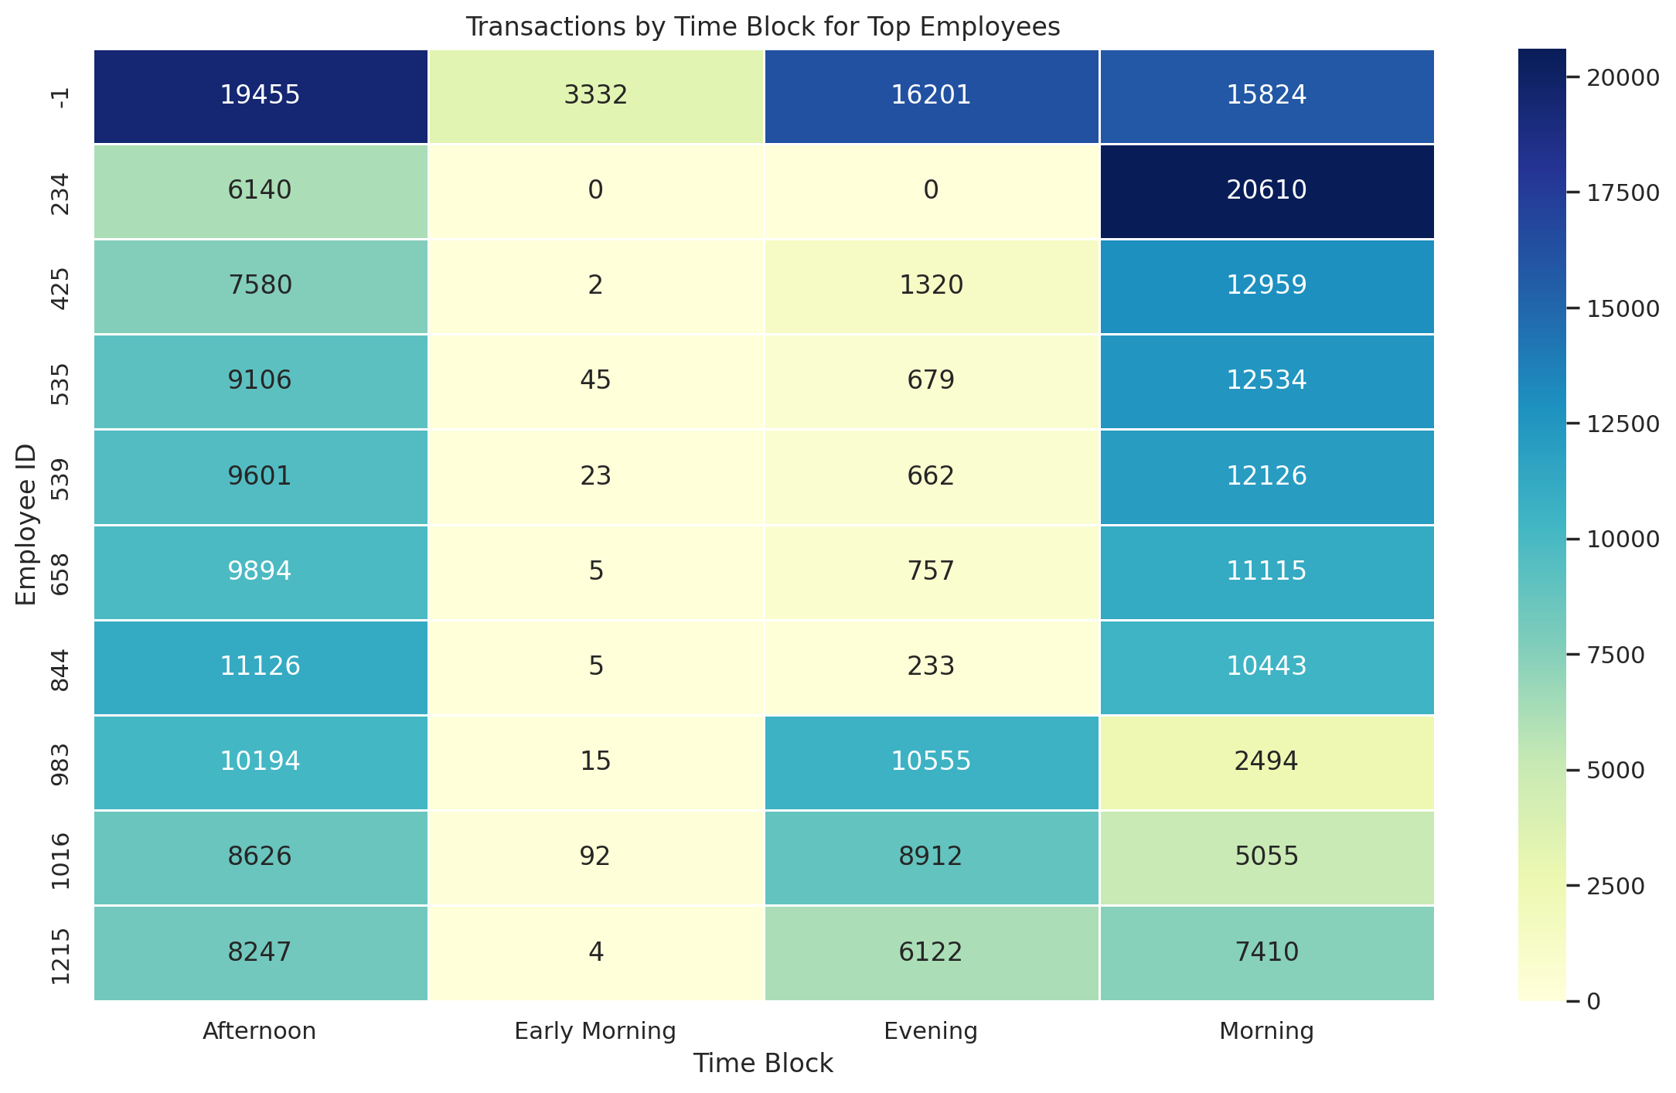
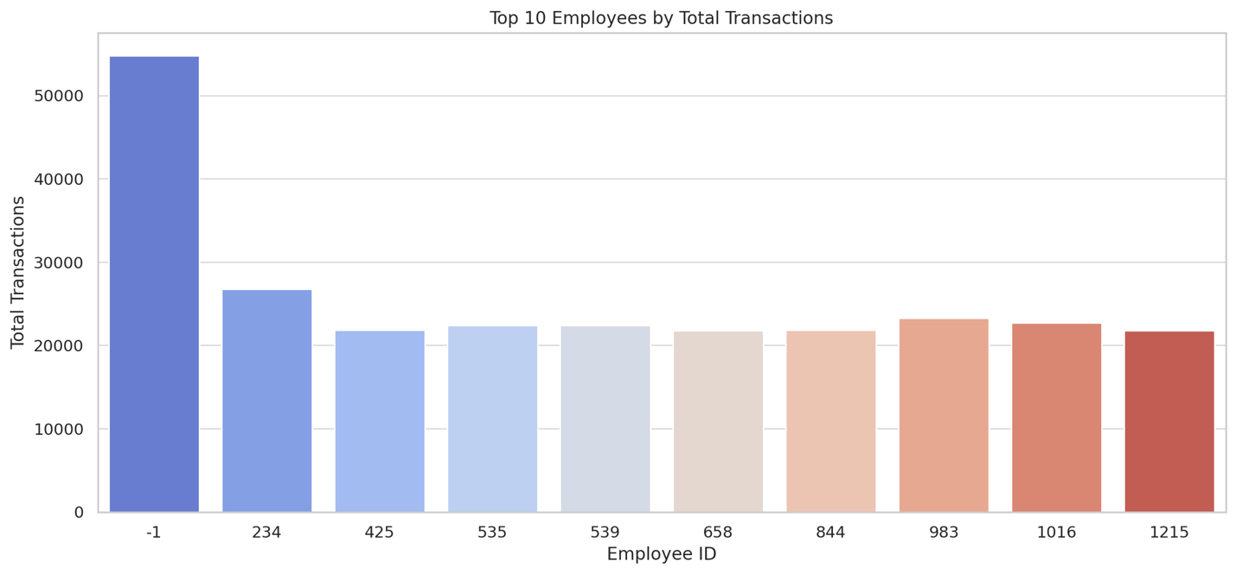
What We Know
Employee -1 has the most processed transaction and the differences with other employees is significant.
The presence of transactions or Employee -1 across various time blocks could indicate an unusual case rather than individual’s activity.

Slide 6
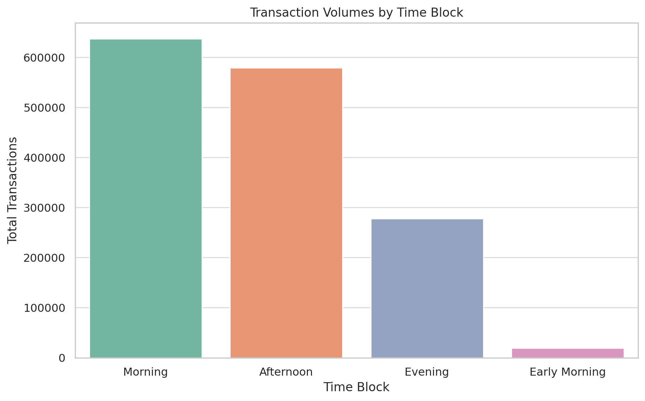
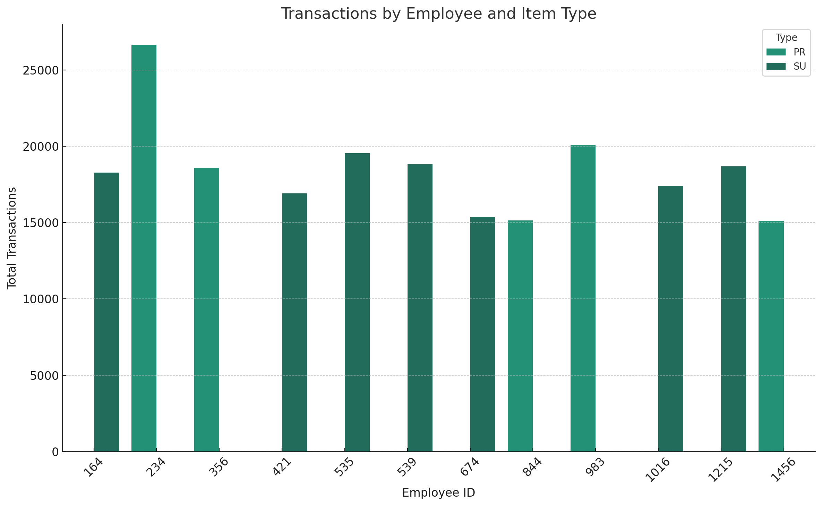
Transaction Volume by Time block
The Morning time block: 6 AM to 12 PM
The Afternoon period: 12 PM to 6 PM
The Evening period: 6 PM to 12 AM
The Early Morning: 12 AM to 6 AM
Certain employees appear to specialize in handling transactions of a specific type

Slide 7
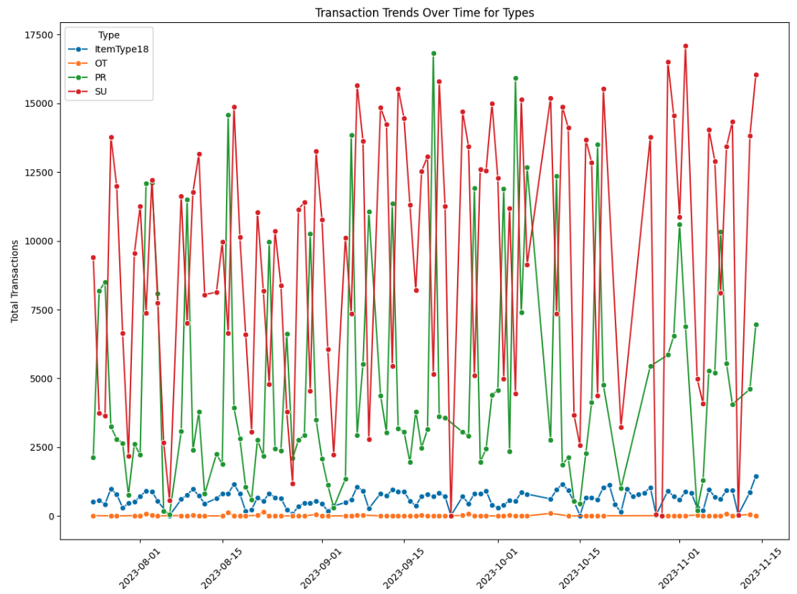
Transaction Trend over time
Distinct Trend: Some Types experience more variability in transactions than others.
Peak Periods: Variability in demand or operational efficiency.
Consistent Performers: Some types maintain relatively consistent transaction volumes over time, suggesting a steady demand.

Slide 8
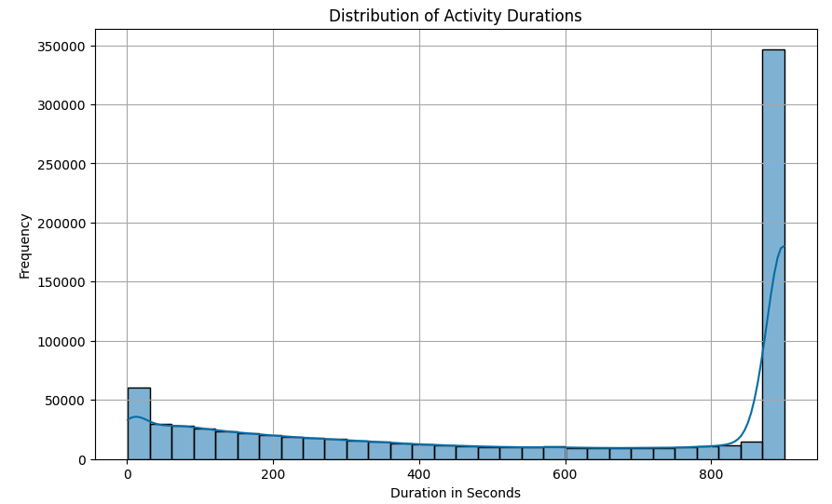
Activity Duration
The Activity Durations includes very short intervals, it could be due to the micro-tasks, such as logging a call or checking status.

Slide 9
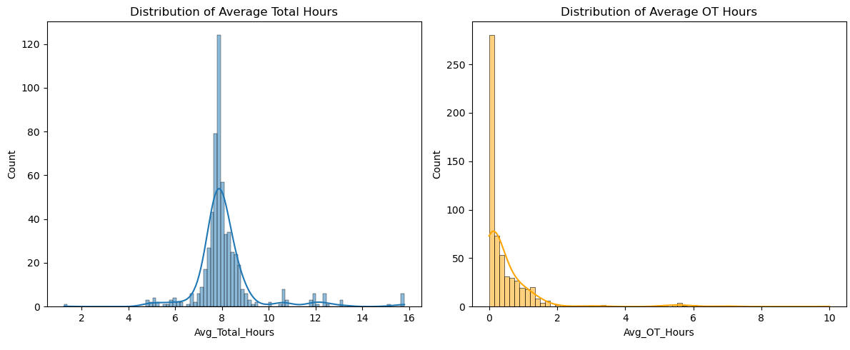
What We Know
Department Level
The data shows a clustering around 6 to 8 hours, suggesting minimal overtime and effective use of regular work hours.
The overtime graph indicates efficient operations with minimal overtime, suggesting cost-effective labor management.

Slide 10
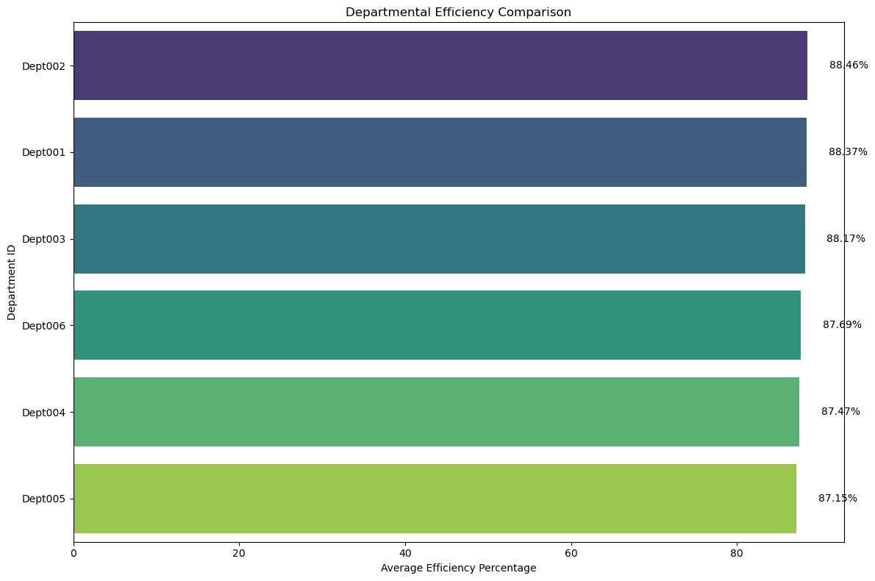
Work efficiency metric - Departmental level
Work efficiency metric = Production hours/(Reg hours+OT)
This approach implies that higher work efficiency is achieved by maximizing production output within the minimum total working hours.

Slide 11
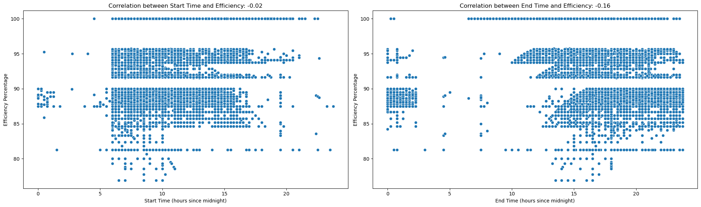
What Do We Diagnose
Does start time and end time of an employee effect the work efficiency?
The nearly flat correlation for start times suggests that there is no discernible relationship between an employee's efficiency and the time they start working.
For end times, the weak negative correlation may suggest that later work hours have a somewhat negative impact on productivity, presumably because longer workdays cause exhaustion.

Slide 12
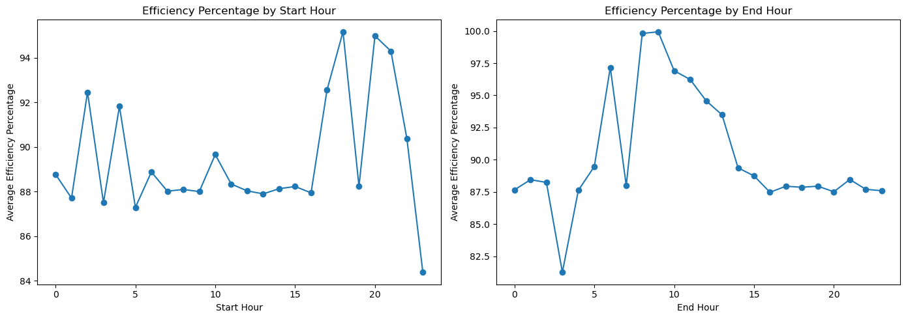
What Do We Diagnose
If so, what start time and end time exactly results in increase in efficiency?
Higher average efficiency percentages are shown during the first hour, which is about 6 AM, and then again at around 8 PM and 11 PM. It implies that shifts starting at these hours would be more effective.
Before efficiency starts to decline, the best end times appear to be in the mid-afternoon, notably around 3 PM. At the end of the late hour, efficiency seems to decline.

Slide 13
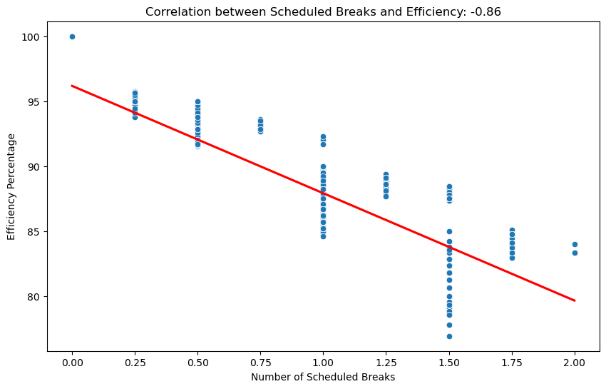
What Do We Diagnose
Does taking break effect the work efficiency?
Correlation: -0.86; There is a strong tendency for the efficiency % to decline as the frequency of planned breaks rises.
A few breaks could increase productivity, but after a while, more breaks have the reverse impact after a threshold level.

Slide 14
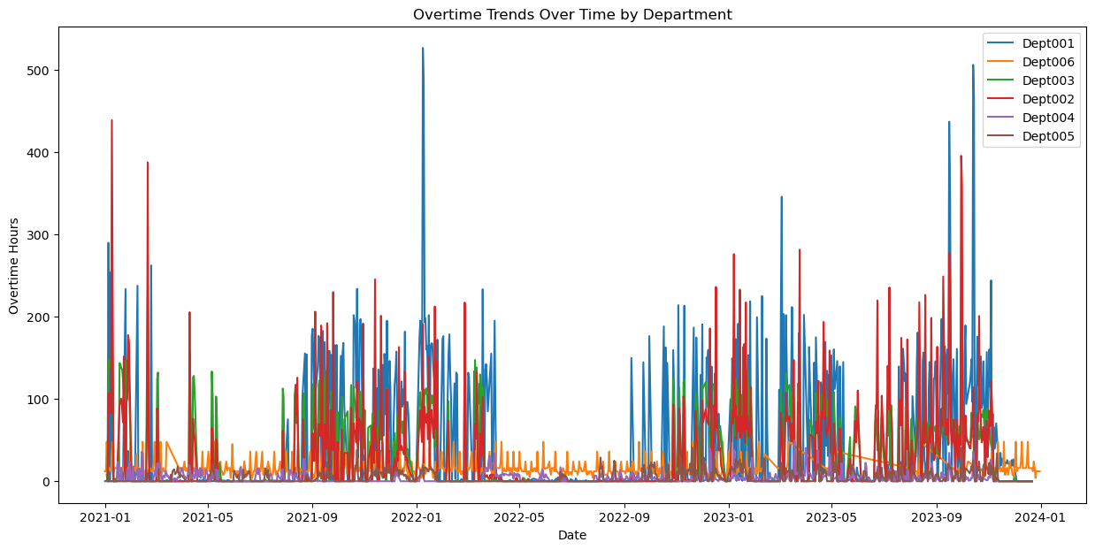
Overtime trends
An early warning system for resource constraints during peak periods is indicated by the cyclical overtime pattern in certain departments, which implies the overtime is linked to business cycles or projects.
Department 001 have the highest peaks and Dept 006,005,004 have lowest peaks.

Slide 15
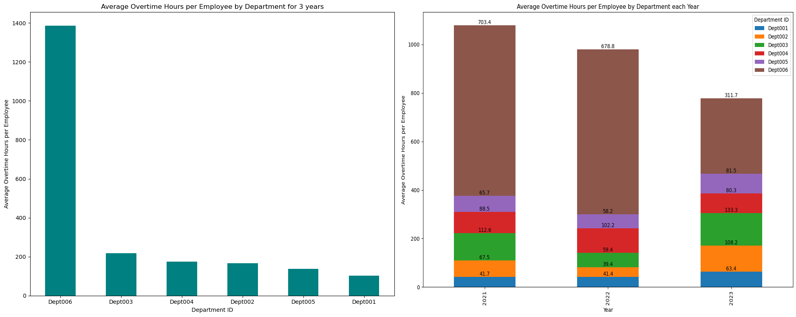
Departments' Dusk to Dawn: The Overtime Narrative
The extreme variance in overtime between Dept006 and other departments compared to others suggests a need to examine its resource distribution and operational efficiency.
When breaking down by year, the average overtime per employee for dept 006 remains high each year. Department 001 can serve as a benchmark for other departments.

Slide 16
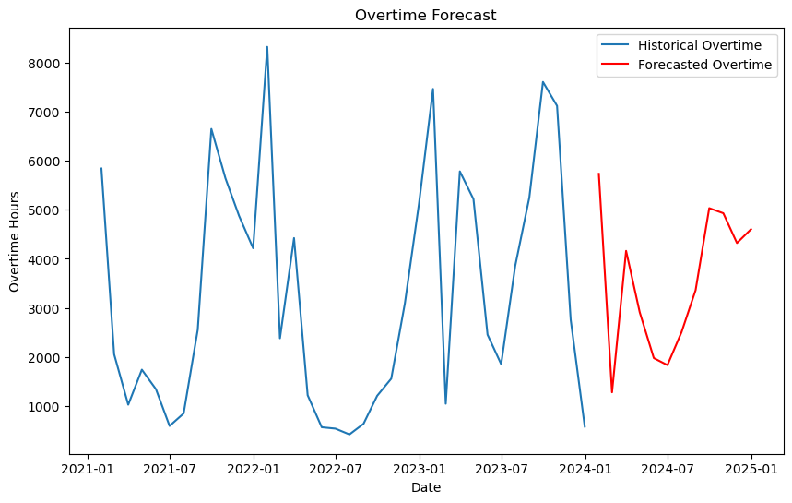
What We Predict
Forecasting Overtime trends using SARIMAX model
These findings could guide strategic decisions on seasonal staffing, facilitating more efficient management of worker workloads and possibly lowering overtime expenses during these busy times.

Slide 17
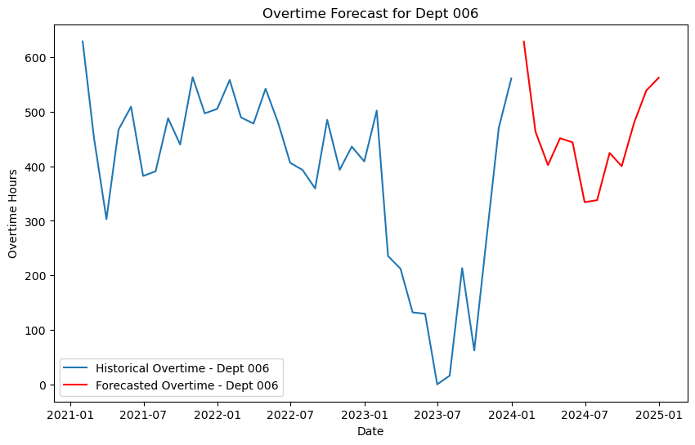
Forecasting Overtime trends for dept 006 using SARIMAX
The forecast reveals upcoming high-workload periods for Dept 006, necessitating advance preparation for uninterrupted operations.

Slide 18
Recommendations
1. Optimize Shift Timings:
Follow efficient Shift hours – Based on start and end time efficiency, considering analysis of average regular work hours as 8 hours
Morning - 7 AM-3PM(8 Hours)
Late afternoon - 4 PM-12AM(8 Hours)
Night - 8 PM-4 AM(8 Hours)
2. Proactive Overtime Management:
Investigate and address causes of high overtime per employee in Dept. 006.
Utilize predictive analytics (e.g., SARIMAX model) to forecast high-activity periods and manage staffing proactively.
3. Break Scheduling Strategy:
Revise break schedules to balance productivity and rest, and overall break schedule not crossing the threshold limit(1.00 hour) to maintain 88% work efficiency.
Pilot and assess impact on productivity and morale.
4. Continuous Monitoring and Improvement:
Establish a framework for regular assessment of shift schedules and break policies.
Create a feedback loop for ongoing adaptation based on data, feedback, and business needs.

Slide 19

THANK YOU

